Slide 1


Consulting Services for
Disaster Risk Management in Lezha
Presentation
Local Emergency Plan & Cost Recovery Mechanism
27 December 2024

Slide 2
Local Emergency Plan?
What is it?
  Guidelines for prefectures and municipalities regarding the preparation of emergency respond schemes for flooding
Audience (interested persons)
  It is mainly addressed to officials of UK Lezha, Prefecture of Lezha, General Directorate of Civil Emergencies of the municipality of Lezha and the irrigation board of Lezha, who are responsible for preparing plans for Disaster Risk Management (DRM).

Slide 3
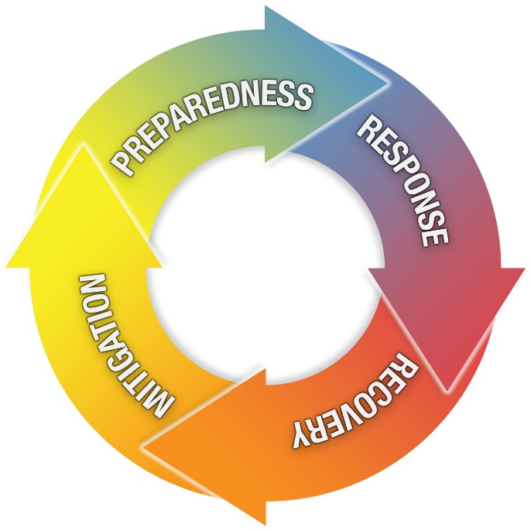
Disaster Risk Management (DRM) = disaster management cycle
4 stages of emergency response planning
Planning & Mitigation:
  Evaluation of the potential types of flooding and the development of plans for reducing their probability or their impact on life & resources
Preparedness:
  Actions to undertake when mitigation efforts have not prevented or are unable to prevent a flooding from taking place.
Response:
  Activities that occur during the flooding that are intended to identify and assist victims and stabilize the overall disaster situation
Recovery:
  Actions following a flooding that aim to restore and to “build back better” . At the end of this phase, a post-flood resilience assessment must be organized to ensure regular updates to the emergency plan.

Slide 4
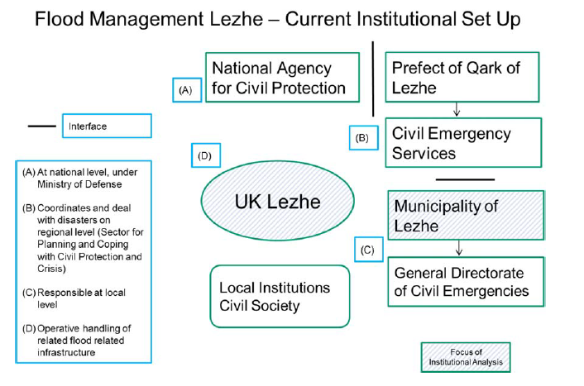
Reference legal framework; current situation

Slide 5
specific duties based on law 45/2019
The NCEP clearly states that “it is the responsibility of authorities at Qark, Commune and Municipal levels to develop contingency plans of their own, which all feed into the National Civil Emergency Plan, and the procedures, roles and responsibilities which it describes.”.
Moreover, the NCEP also calls for a more efficient Early Warning System (EWS) by stating that:
“It is the responsibility of the Department for Civil Emergency Planning and Response and concerned local authorities, to ensure that all stakeholders are conversant with the local and national early warning systems and necessary contacts and procedures. It is also the responsibility of the civil emergency structures at central level and designated civil emergency officials at Qark, Commune and Municipality levels, to ensure that timely and appropriate warning messages are broadcast to the public and institutions, advising them of the risk and the necessary steps for them to take.”

Slide 6
gap analysis in the report Improving disaster risk and loss information in Albania – 2022 of the World Bank Group
local authorities and institutions still face several challenges in meeting their responsibil­ities defined by the Law
  In data collection process and the maintenance of databases for damage and loss after natural or man-made hazardous events.
  in the risk assessment,
  in drafting local emergency plans,
  in the development of investment plans for disaster prevention, protection and reha­bilitation,
  in managing monitoring and early-warning systems and similar.
  In providing risk and loss related data to the National Civil Protection Agency (AKMC), who shall establish and operate the National Disaster Losses Database. According to the Law, risk and disaster loss data shall exist at three levels - municipalities, prefectures, ministries and central institutions - and shall be managed on a national level by AKMC.

Slide 7
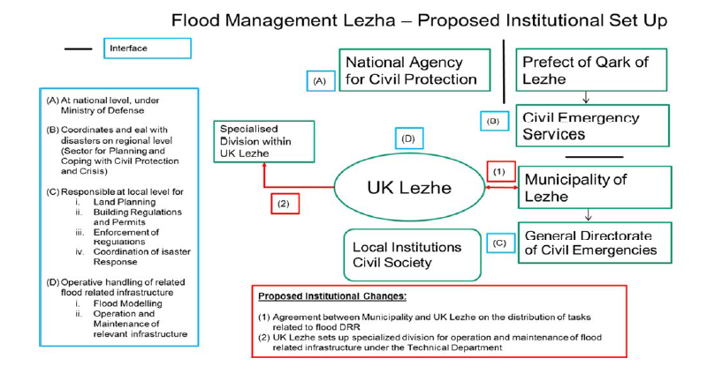

Slide 8
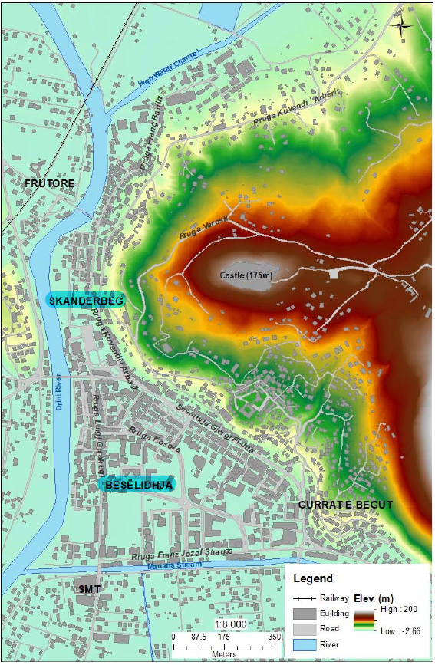
Summary of flood risk analysis
It is generally a relatively small area that regularly floods - up to 10 times a year - causing economic damage to the affected families. Due to pipe blockages and limited capacity of the existing sewer network, surface flows which cannot enter the network collect in the lower lying areas of the city, these being:
the area south of Park 11 Janari
along Rruga Kosova near the high school
around Apartment “11.2 Ha” (off Rruga Franz Josef Strauss),
in Varosh Gurra (located immediately opposite the intersection with the new hospital road)

Slide 9
Summary of flood risk analysis
Affected more than 10 times a year by floods, with the duration of flooding exceeding 24 hours 93% of the time, and not less than 6 hours.
The depth of flooding on each occasion was over 50cm 36% of the time, and not less than 20cm.
The source of the flood was approximately equally divided between roads, nearby drains and manhole surcharging.

Slide 10
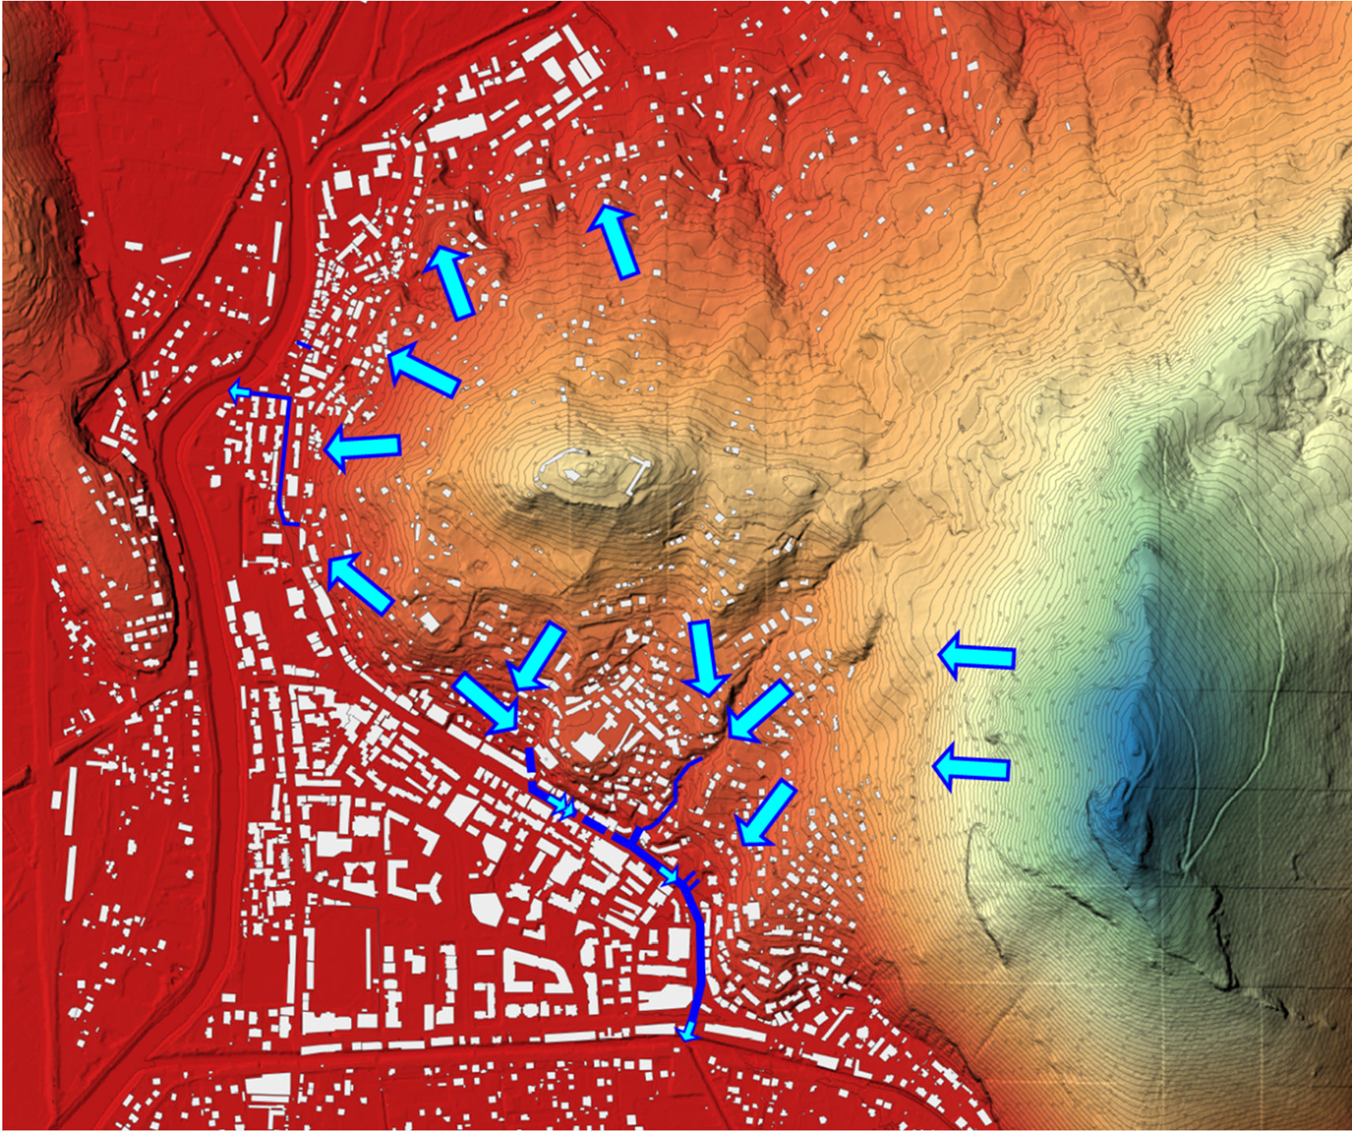
The Municipal Infrastructure V Project :comprehensive revision for the entire stormwater and wastewater infrastructure.
deviation concept of surface discharge: drain the accruing stormwater flow from “high level areas“ (at the hillsides) via stormwater culverts in gravity flow to the Drini River, respectively to Manatia Stream.
Separation of stormwater and wastewater: Accordingly, the newly designed sewer system is engineered to accommodate a certain volume of rainwater.
Parts of the city center will retain a combined sewer system

Slide 11
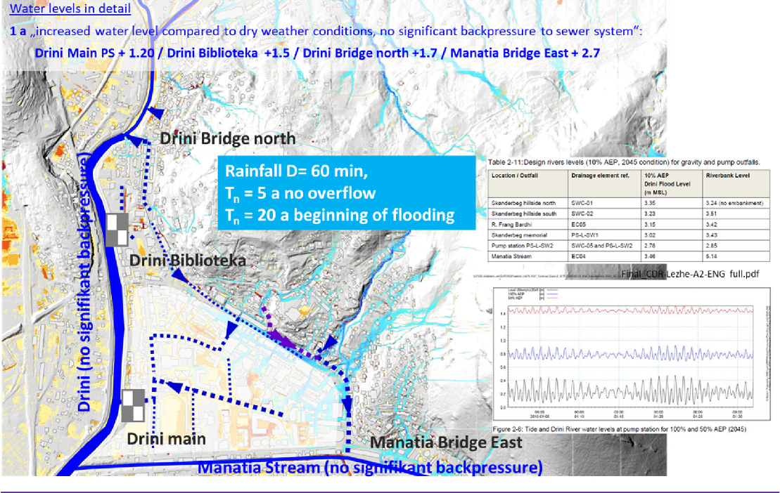
Residual Flood Risk
As part of the Municipal Infrastructure Programme V in Lezha, flooding simulations were conducted based on several scenarios. These simulations employed a coordinated approach, factoring in future design flood levels while considering the effects of climate change and sedimentation in the Drini River.
with significant backpressure (normal water level) of the Manatia river a rain event recurring every 20 years should trigger flooding

Slide 12
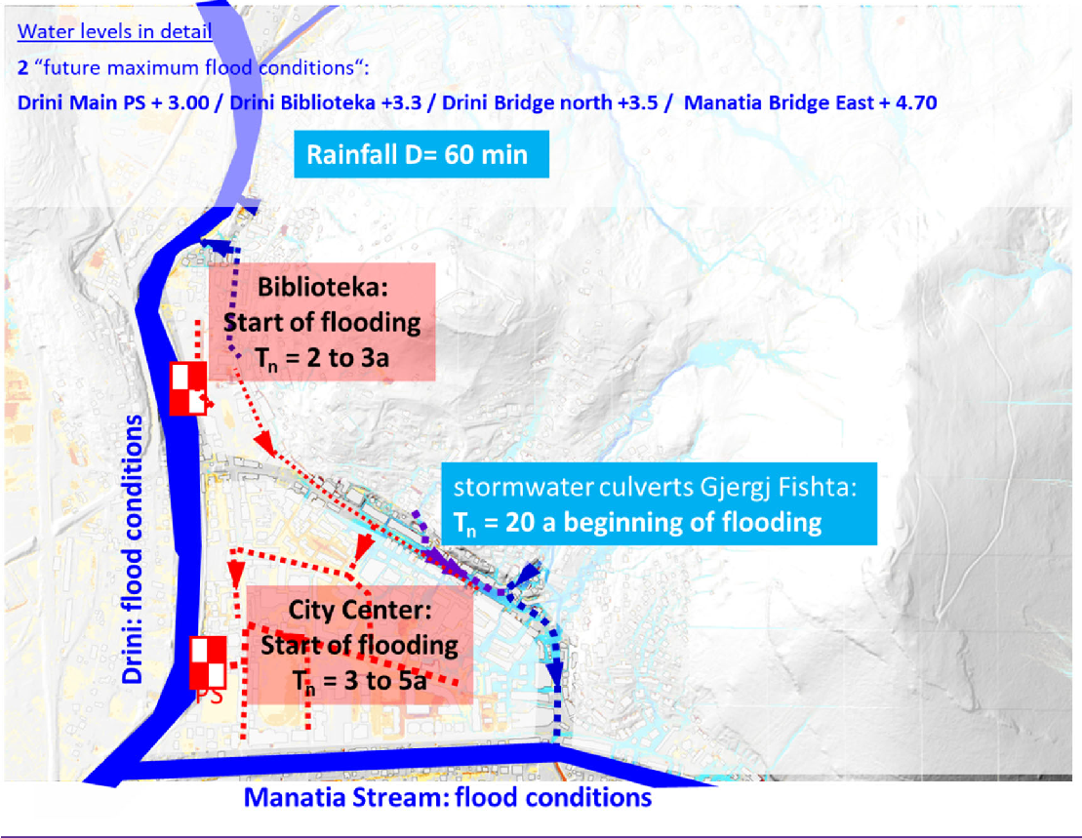
Residual Flood Risk
with flooding condition of the Manatia river a rain event exceeding recurring every 3 to 5 years should trigger flooding in the centre city of Lezha.

Slide 13
Residual Flood Risk : focus of a civil protection plan
The implementation of the proposed flood protection measures offers relief against a 20% Annual Exceedance Probability (AEP) flood event under current climate conditions. A 20% AEP event therefore has a 20% chance of being exceeded in any one year, and is approximately the equivalent of the five year storm.
Indeed, the focus of a civil protection plan for Flood Risk Management extends beyond the question of whether flooding will occur or how to prevent it. Instead, it centers on acknowledging the inevitability of future flooding events and focuses on mitigating their impacts and minimizing associated losses.

Slide 14
Early warning
Real time monitoring: Monitoring and dissemination of Daily Bulletin on Natural Hazards from - IGEO - The National Center for Forecast and Monitoring of Natural Hazards (NCFMNH).
Status Indicators: Status Indicators (SI) are derived by the real-time or near-to-real time observations of the event and of its impacts on the territory as it unfolds. This is done mainly through:
National Weather Stations network & NCFMNH
Communication of assessment teams deployed on the field (UK Lezha, Albanian Red Cross, agriculture irrigation board,)
Communication from other institutional stakeholders (I.e. neighboring municipalities, Prefecture, irrigation boards, General Directorate of Civil Emergencies, etc.)
Population through institutionalized communication channels (emergency numbers)

Slide 15
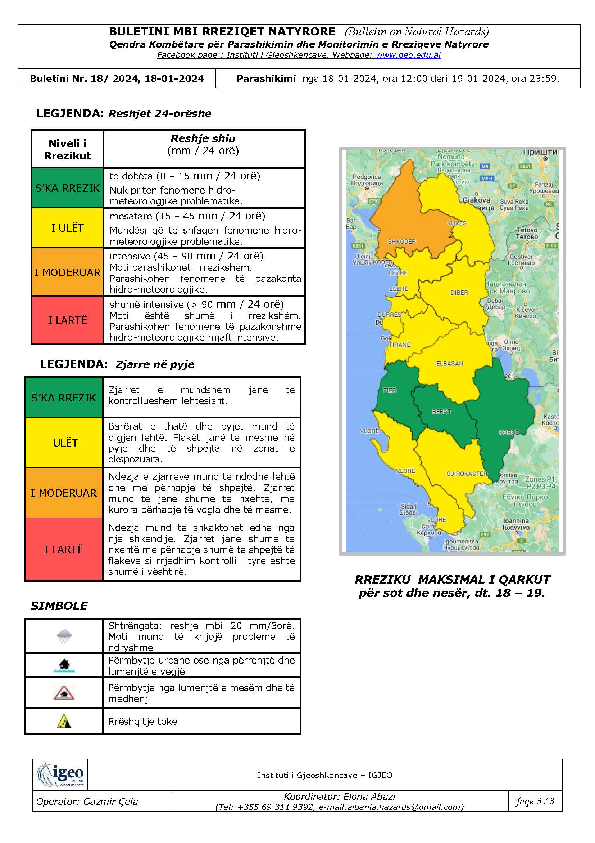
Early warning
Context indicators: indications given by the bulletin produced daily by IGEWE, providing the evaluation of the hydrometeorological risk. Keeping in mind that the thresholds provided are only pluviometric
The forecasts provided by the NCFMNH are categorized into four risk levels:
      Green (null criticality)
      Yellow
      Orange
      Red
Rainfall intensity serving as the basis for classification. These forecasts cover a time span of "today and tomorrow" and are limited to a maximum of 36 hours (refer to the annex), meaning that the preparation window is less than 36 hours.

Slide 16
Problems encountered
General problem: The forecasts issued by the National Center for Forecasting and Monitoring of Natural Hazards (NCFMNH) lack both accuracy and timeliness ( exemples given the severe floodings on 19th and 20th of March 2024
The bulletin of March 18th is mentioning: YELLOW medium (15 – 45 mm / 24 hours); Possibility of problematic hydro-meteorological phenomena
The bulletin of March 19th in mentioning: ORANGE intensive (45 – 90 mm / 24 hours) The weather is forecast to be hazardous. Unusual hydro-meteorological phenomena are predicted.
It remains unclear when to classify a situation as high risk, as the threshold for such determination is not firmly established.

Slide 17
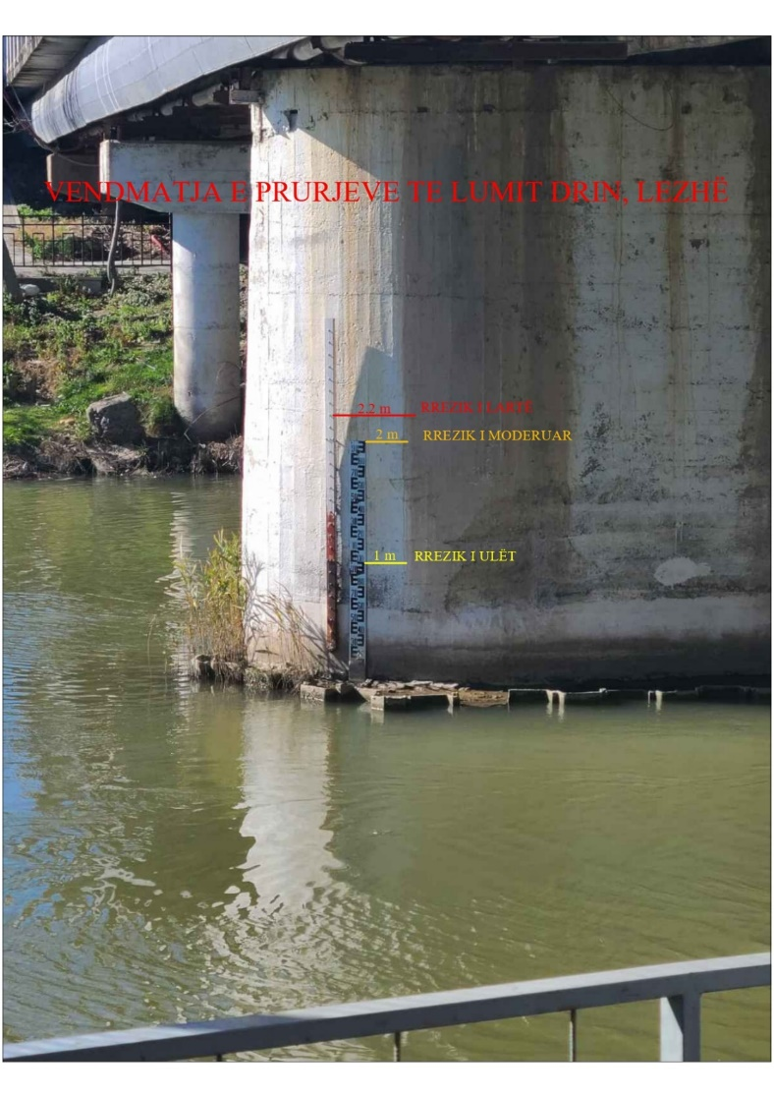
Points of improvement
The forecasts furnished by the NCFMNH rely on data from the meteorological station of Lezha, which is a manual station. Data from manual stations are recorded in a traditional manner, requiring the presence of an observer, Data from the manual monitoring stations are collected twice daily by observers at 7:00 and 19:00: time consuming
Make natural hazard bulletins available 365/365. An analysis of the available hazard bulletins on the NCFMNH website reveals that no observation and hazard bulletins are generated on Sunday. This implies that approximately 14% of timely observations are unavailable, diminishing the reliability and completeness of the information provided.
Manual gauge is employed to monitor the water level of the Drin River .This gauge plays a crucial role in monitoring river levels and informing flood risk assessments and management efforts

Slide 18
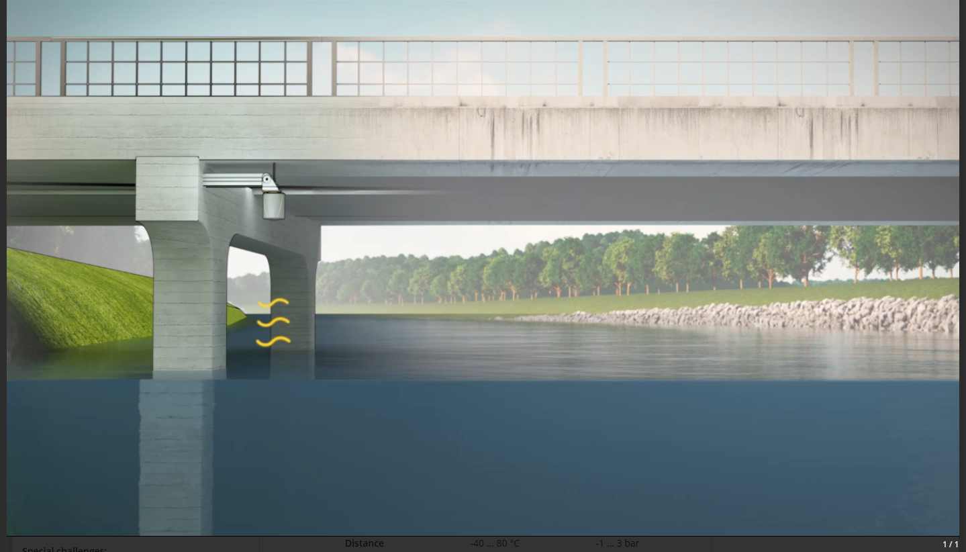
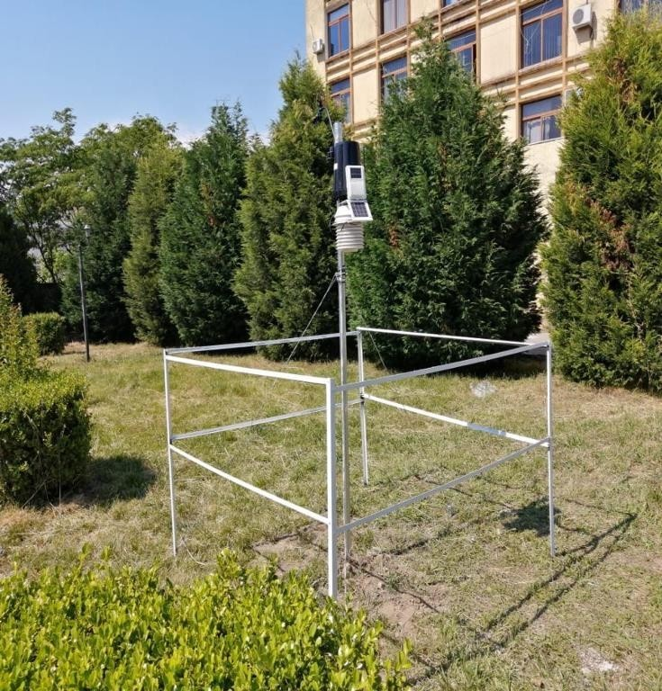
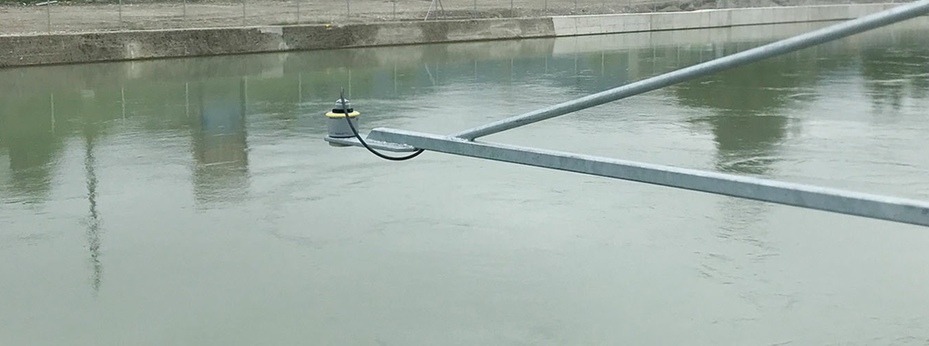
Points of improvement
Given Lezha's susceptibility to flooding, the installation of equipment to monitor the water level of the Drin River is deemed indispensable.
  Installation of an Automatic Thermometric and Pluviometric Meteorological Station: Introducing automatic meteorological stations in Lezha offers several advantages. These stations conduct frequent meteorological measurements at regular intervals,

Slide 19
Points of improvement
Integration of meteorological forecasts with real time local rainfall and river level data is proposed to be included in the new Besalidhja stormwater pump station with SCADA system.
  This will make monitoring data accessible via web and smartphone apps 7/7 and 24/24h. This real time monitoring equipment should be provided to UK Lezha as part of the Besalidhja pump station.
Engaging the local community of the centre of Lezha in stormwater monitoring can be an effective strategy to prevent intake points from becoming blocked due to sand and debris accumulation. Here are some ways to involve the local community
  Awareness Campaigns:
  Adopt-a-Drain Programs: Establish an adopt-a-drain program where residents can volunteer to adopt specific stormwater drains or intake points in their neighbourhood.
  Citizen Reporting Platforms: Set up a citizen reporting platform where residents can easily report blocked intake points or other stormwater-related issues. This could be through a mobile app, website, or hotline.
  Training and Education: Provide training sessions and workshops to community members on how to properly maintain stormwater intake points.

Slide 20
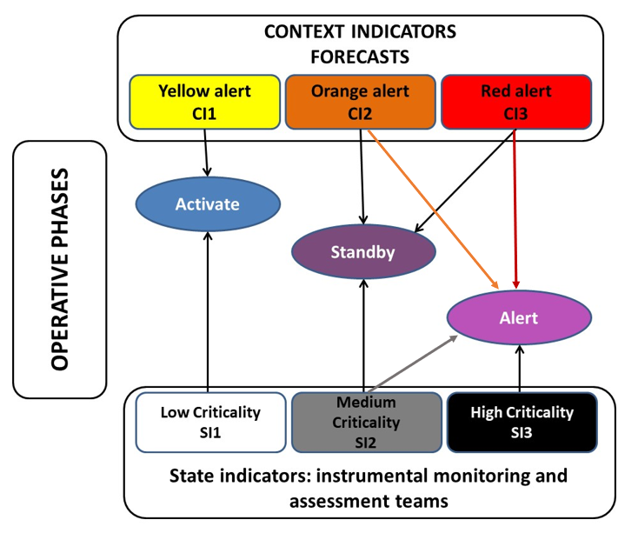
OPERATIONAL PHASES: emergency respond scheme

Slide 21
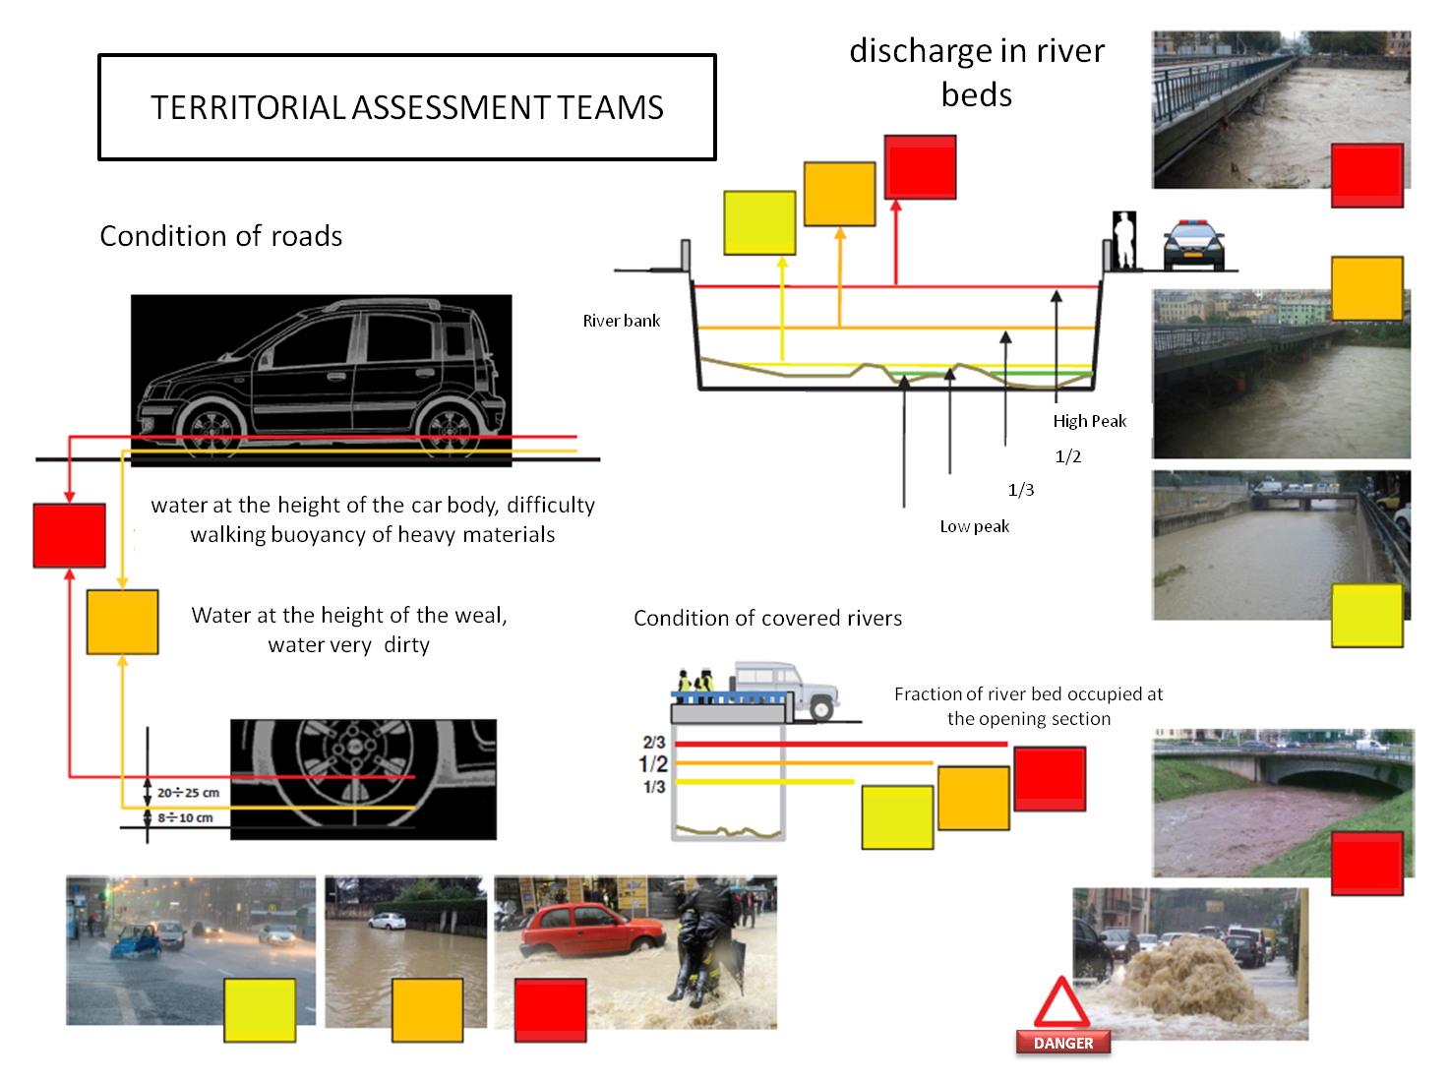
Territorial assessment teams
Activities of assessment teams are conducted in a dynamic way. According to pre-established routes (to be developed with a participatory procedure including the population and all stakeholders in their determination) and control cards;
Personnel from the prefectures or municipalities, trained volunteers and other designed experts use recognizable vehicles possibly equipped with radio and / or telephone communications systems.

Slide 22
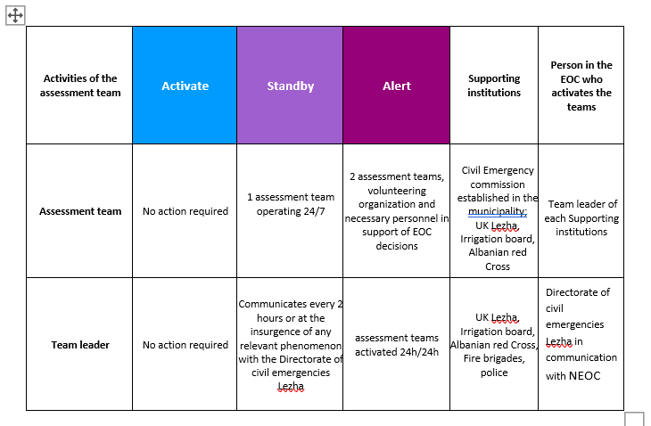
Territorial assessment teams

Slide 23
Respond scheme in case of flooding alert
The response scheme to cope with a flooding alert in Lezha involves a systematic and coordinated approach to mitigate risks, ensure public safety, and minimize the impact of the flood event in 10 phases.
1. Early Warning System Activation:
2. Alerting and Communication:
3. Emergency Operations Center Activation:
4. Evacuation Planning and Execution:
5. Resource Mobilization:
6. Public Safety Measures:
7. Monitoring and Assessment:
8. Community Support and Assistance:
9. Recovery and Rehabilitation:
10. After-Action Review:

Slide 24
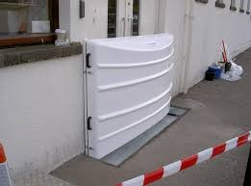
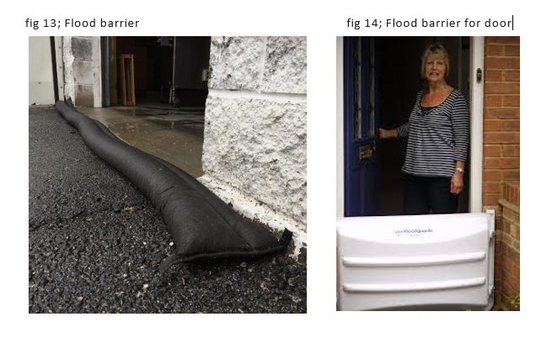
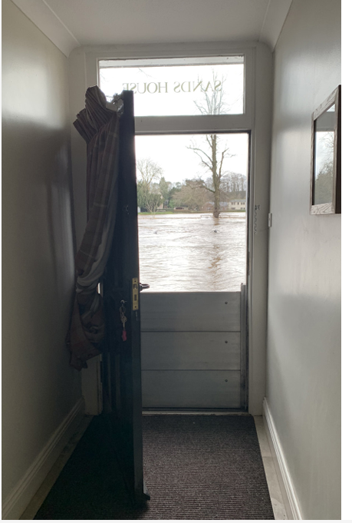
Flood resistance approach

Slide 25
Action Plan for DRM cost recovery in Lezha: Estimated Budget for DRM Action Plan (2025-2027)
.
A Information, Awareness, and Community Capacity Building:
  Training of Volunteer Groups: 120,000 LEK
  Community Training: 120,000 LEK
  Awareness Campaign for Sewage Channel Cleaning: 60,000 LEK
B Raising Institutional and Government Capacities:
  Training of Civil Defence Committee: 120,000 LEK
  Review of Local Territorial Plan: 100,000 LEK
  Establishment of DRM Database: 50,000 LEK

Slide 26
Action Plan for DRM cost recovery in Lezha: Estimated Budget for DRM Action Plan (2025-2027)
C Measures for Disaster Risk Reduction:
  Maintenance of Primary Canals: 53,000,000 LEK
  Maintenance of Secondary Canals and Equipment Purchase: 25,000,000 LEK
  Temporal Flood Barriers and Levees: 200,000,000 LEK
D Building Institutional and Operational Capacities:
Establishing Early Warning Systems: 150,000,000 LEK
Total Estimated Budget for DRM Measures: Approximately representing 4.5% of Lezha’s total budget.

Slide 27
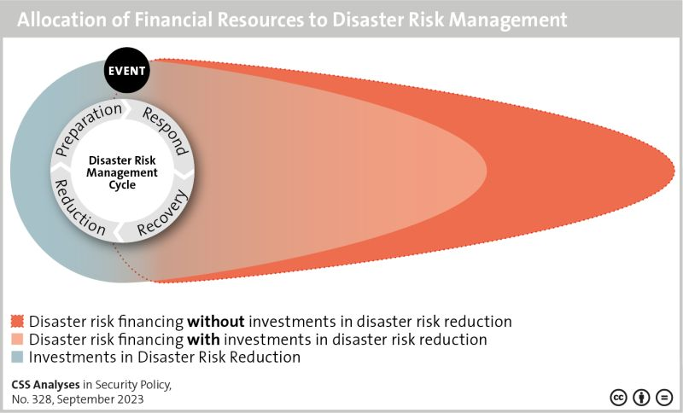
Investment in DRM
Investments in DRM yield economic, social and environmental benefits; in a middle income country as Albania, UNISDR is calculating that investing US $1 in DRM returns US $4 in benefit
Figure illustrates how investments in Disaster Risk Reduction (DRR) lead to significant gains for the overall budget of Disaster Risk Financing (DRF).

Slide 28
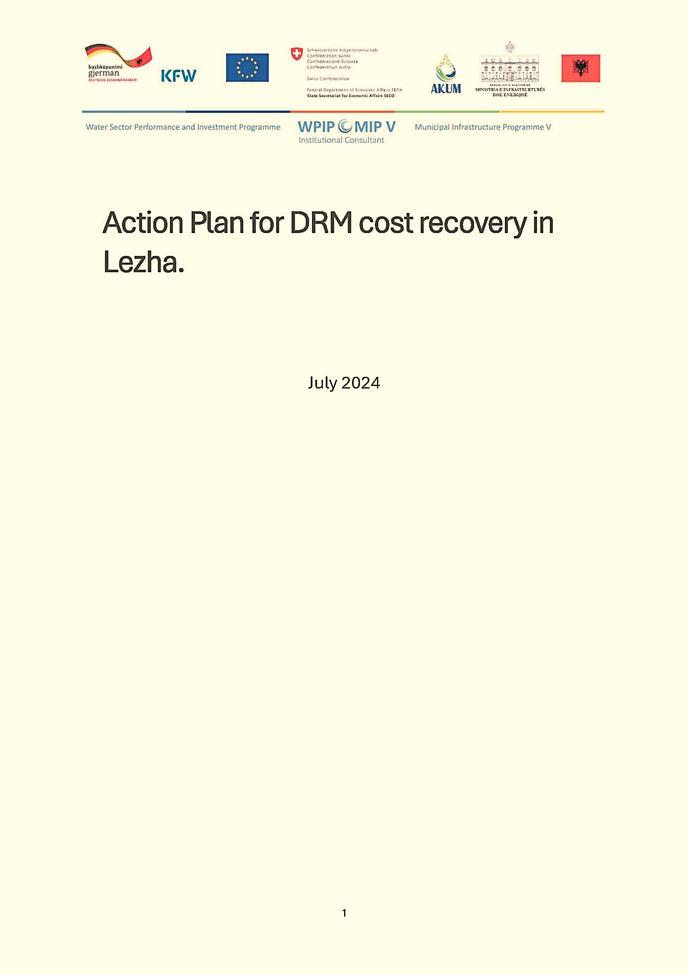
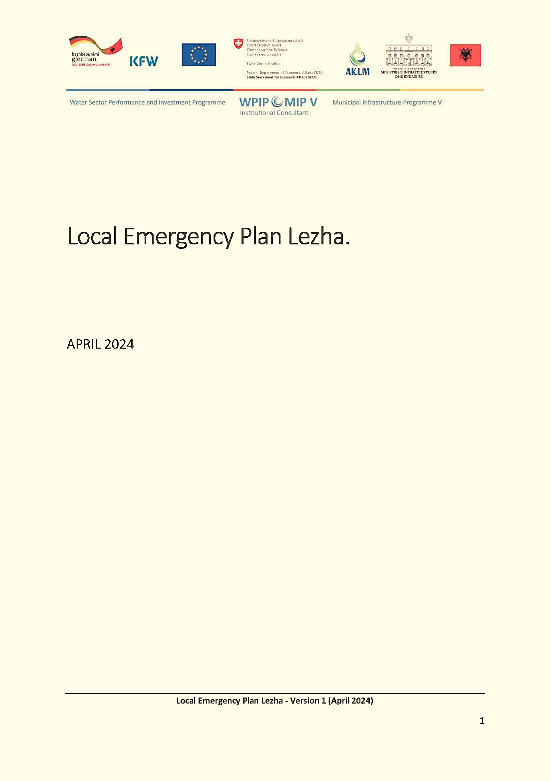
Documents delivered to Lezha municipality

Slide 29
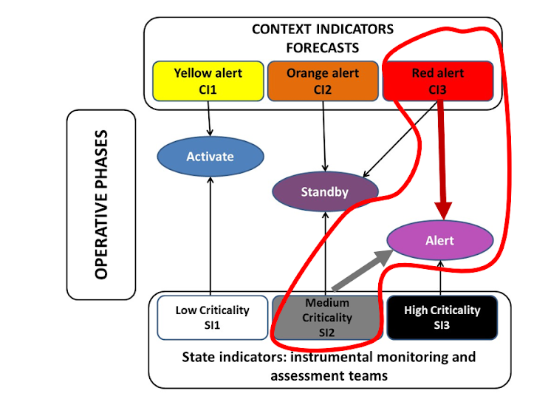
Simulation exercises; scenario
Flood alert circumstances:
(cfr LEP pg 38 and pg 82)
SI2 Medium critically = significant backpressure (normal water level) of the Manatia river in combination with
CI3 red alert; Tn= 20 a = rain event recurring every 20 years

Slide 30
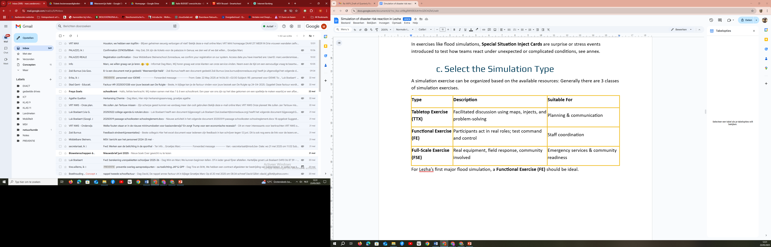
Select the Simulation Type

Slide 31
During simulation; Special Situation Inject Cards; exemple 1
Pumping Station Failure
Inject Time: 1 hour after simulation start
Situation: The main municipal pumping station has stopped due to electrical failure. Engineers estimate 4–6 hours for repairs. Backup portable pumps are available but require manual setup.
Expected Actions:
- Activate emergency repair teams.
- Communicate immediately with the Incident Commander.
- Deploy backup portable pumps or redirect water if feasible.

Slide 32
During simulation; Special Situation Inject Cards; exemple 2
Responder Team Stranded
Inject Time: 3.5 hours after simulation start
Situation: A civil protection team becomes stranded while inspecting a flooded area and requires immediate rescue.
Expected Actions:
- Dispatch rescue resources to recover the team.
- Prioritize responder safety in rescue operations.
- Update the Incident Commander on the situation status.

Slide 33
Lessons learned..stepwards
1.After-Action Review (AAR)
Right after the exercise:
Key questions;
  What went well?
  What challenges did we face?
  What needs improvement?
Within 24–48 hours:
Gather all participants for a debrief
Discuss what went well, what failed, and what needs to change
Record all lessons learned
3. Integrate Learnings into Policy
Update the Municipal Flood Emergency Plan
Revise coordination protocols
Plan follow-up trainings (e.g., on weak areas like communication or evacuation)
2. Create an AAR Report including:
Timeline of actions
Decisions and outcomes
Coordination gaps
Recommendations

Slide 34

Thanks for your attention

