Slide 1
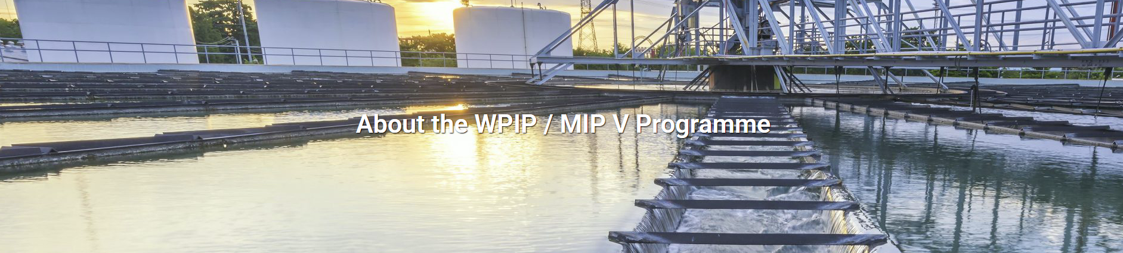
Quantitative Study Report on WPIP/MIP V Programme
Implemented by: Data Centrum Research Institute
February 2025

Slide 2

Research objectives
The research has two main objectives:
i) to measure the awareness and expectations of the residents on the WPIP/MIP V investment program aimed at improving water and wastewater services by focusing on different municipalities.
ii) to measure the awareness and satisfaction of the residents with the water and wastewater services provided by their respective municipality.

Slide 3
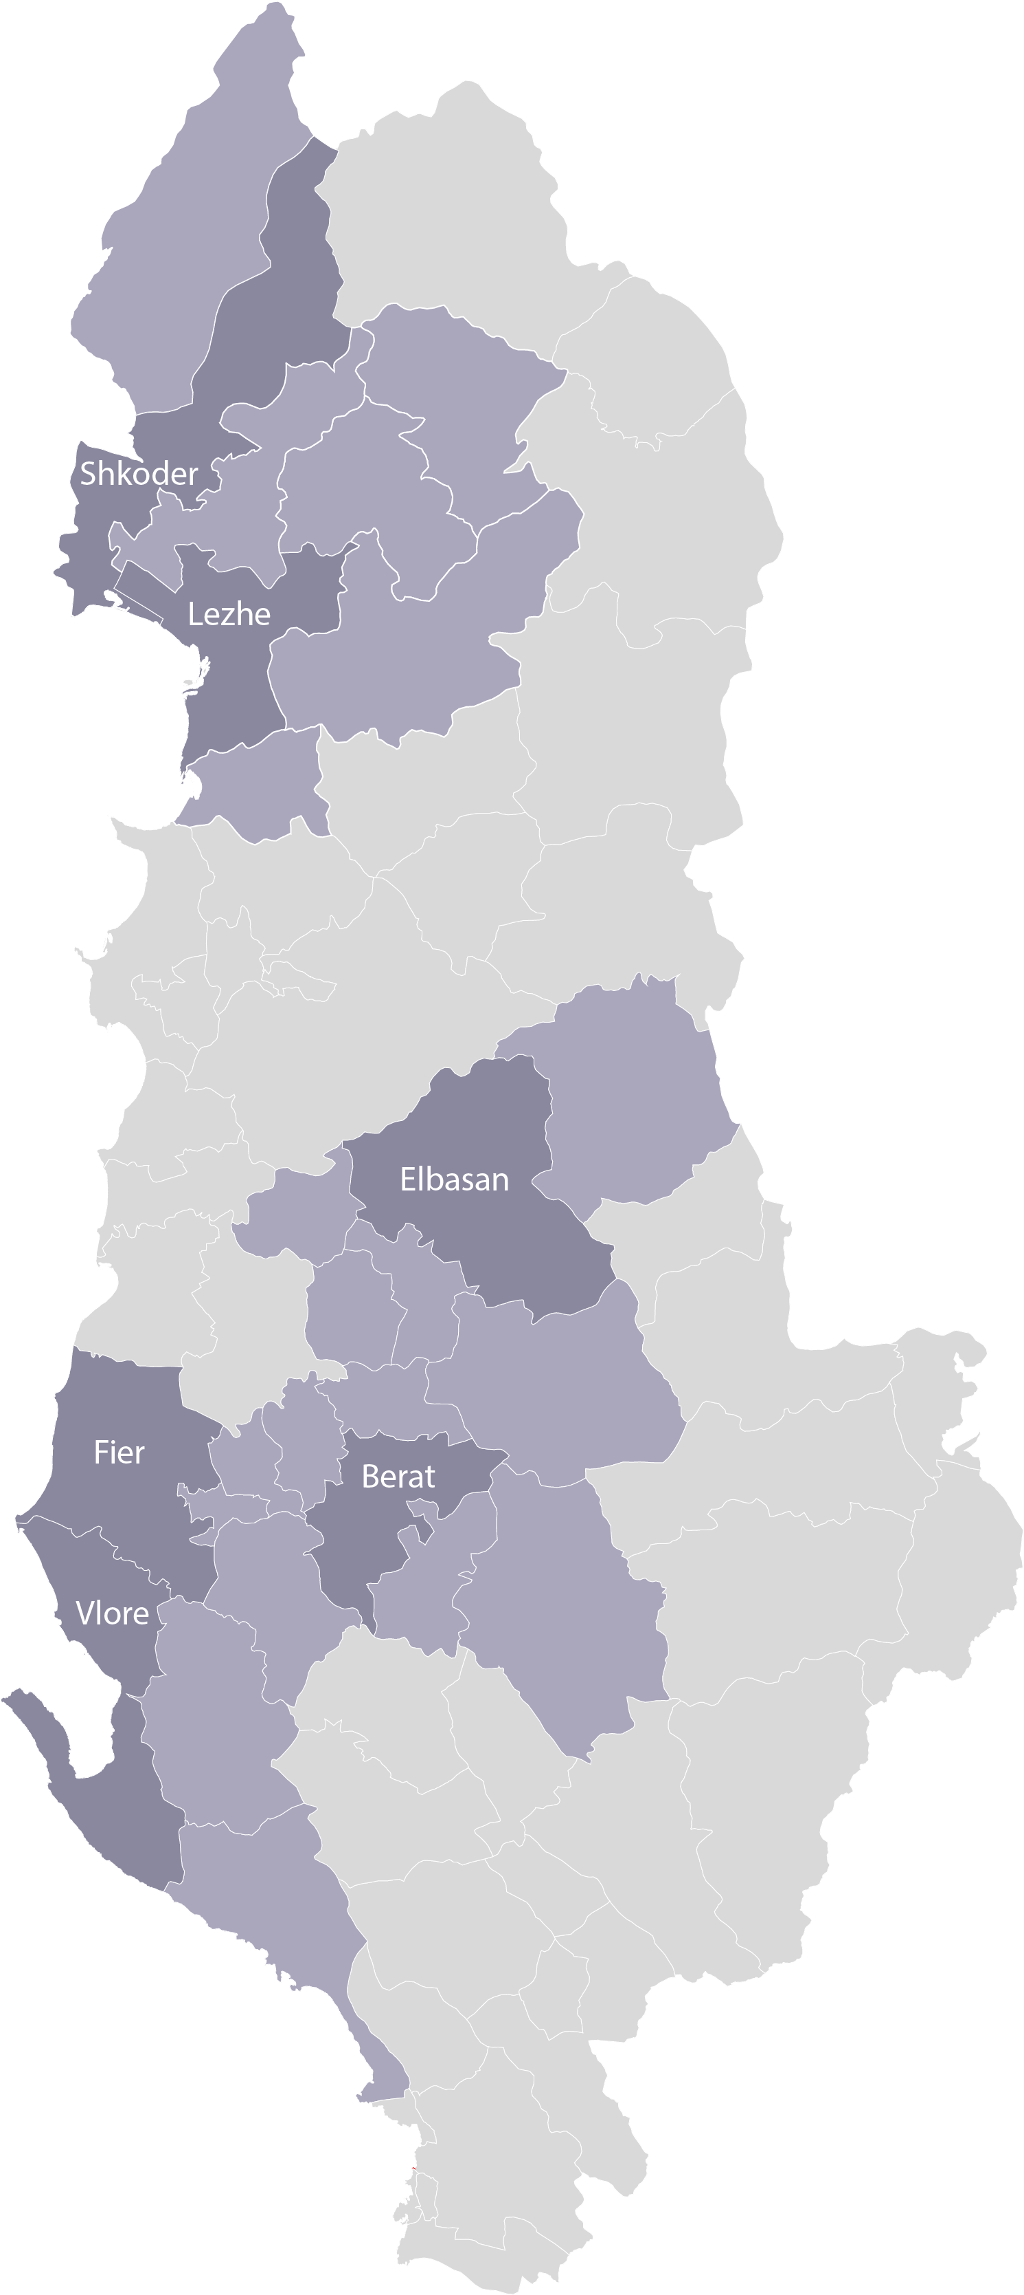
Methodology
 | Quantitative survey, Face-to-Face, Door-to-Door interviews using a structured questionnaire in form of CAPI (computer-assisted personal interviewing) with average length of interview 12 minutes
 | The survey was conducted in the municipalities of Berat, Fier, Elbasan, Lezhe, Shkoder, Vlore Resident in the respective Municipalites, 18+ years old, male & female Representative sample n=800, by using multi-stratified sampling technique.
 | Fieldwork dates: 23.12.2024 up to 14.01.2025
 | 3,810 household have been contacted in total to achieve the required sample, achieving a final response rate of 21%.
Method
Sampling
Target group
Timeline
Response rate
Data Centrum as an official member of ESOMAR (European Society for Opinion and Market Research) fully complies with the provisions of the ICC/ESOMAR International Code on Market, Opinion and Social Research and Data Analytics and implements ESOMAR the fieldwork quality standards.

Slide 4
1. Awareness of Municipal Water and Wastewater Services
The study reveals that 46% of respondents claim to be well-aware of the water and wastewater services provided in their municipalities.
Regarding the main objectives of municipal water and wastewater services, 55% of respondents are aware.
Residents show a slightly higher awareness of water services over wastewater services.
About 37% of respondents report frequent issues with water supply including limitations on water availability, dirty or substandard water, and low water pressure. Hence only three out of ten respondents' express satisfaction with water supply services and wastewater services
Overall, the findings indicate a mixed awareness of municipal services, prevalent issues with supply and wastewater, and generally low satisfaction among the residents.
*Total Sample n=800
*All the data are expressed in percentages %

Slide 5
Awareness of water and wastewater services provided in their municipality
1.How well do you know the water and wastewater services provided in your municipality?
46% of the respondents claim that they know well the water and wastewater services provided in their municipality. Slightly higher awareness in Berat (52%) and Lezhe (50%), while lower in Fier (41%) and Elbasan (41%).
Awareness level:

Slide 6
Awareness of water and wastewater services provided in their municipality-age group
1.How well do you know the water and wastewater services provided in your municipality?
46% of the respondents claim that they know well the water and wastewater services provided in their municipality. Slightly higher awareness for older group of ages compared to younger ones. 66+ years olds are the ones that know more about the water and wastewater services provided in their municipality.
Age Group:
Awareness level:

Slide 7
Awareness of the main objectives of Municipality for water and wastewater services
2.Do you know the main objectives of your municipality as regards water and wastewater services?
55% of the respondents claim they know the main objectives of their municipality as regards water and wastewater services, while 46% claim they don’t know such objectives or are not sure.
3.According to you, what are the objectives of the municipality as regards the water utility? Spontaneous
The objectives most mentioned spontaneously are: “24-hour water supply”, “Drinkable, good quality of water”, “ Maintenance of the wastewater system”, and “collection of fees/payments”.

Slide 8
Awareness of main services provided by the municipality
4.Let’s list some of the main services provided by your municipality as regards water and wastewater, and let me know if you are aware that the municipality provides such services:
They are slightly more aware of the water services, vs. wastewater services. The water services that they are less aware of are: Managing arbitrary network intrusions by private entities and Managing abuses of the network by residents. The wastewater service that they are less aware of: Construction of side additions to the buildings over the existing sewerage network.

Slide 9
Issues with water supply and frequency
37% reported often or very often issues with water supply in their area. The main issues mentioned spontaneously are: Limitation of water supply, Dirty, not clean water, and no quantity/no pressure of the water. The residents in Elbasan and Vlore municipalities seem to encounter issues more often than others.
5. How often do you encounter issues with water supply in your area?
6. What types of issues do you encounter with water supply? Spontaneous
Base: Those who have encountered problems with water (567)

Slide 10
Issues with wastewater and frequency
20% reported often or very often issues with wastewater in their area. The main issues mentioned spontaneously are: Blockage of septic tanks especially after the rain, the sewage comes to the surface and the bad smell. The residents in Lezha municipality reported the issues most frequently.
7. How often do you encounter issues with waste water services in your area?
8. What types of issues do you encounter with waste water services? Spontaneous
Base: Those who have encountered problems with wastewater (411)

Slide 11
Satisfaction with water supply services
9.How satisfied are you with the following main services provided by your municipality as regards water and wastewater? Please answer on a scale from 1-5 where 1 means totally dissatisfied, 3-Neutral and 5 Totally Satisfied
When asked about their satisfaction with main services provided by their municipality as regards water, on average 3 out of 10 of them are satisfied, while 5 out of 10 not satisfied. They are mainly not satisfied with the quality of the water supplied and the amount/price paid to UKR

Slide 12
Satisfaction with water supply services
Municipality analysis (T2B – categories ‘satisfied’ and ‘totally satisfied’)
9.How satisfied are you with the following main services provided by your municipality as regards water and wastewater? Please answer on a scale from 1-5 where 1 means totally dissatisfied, 3-Neutral and 5 Totally Satisfied
When we analyze the T2B (Top 2 boxes – the two categories ‘satisfied’ and ‘totally satisfied’), according to each municipality, it is noted that the residents in Berat and Lezhe are mainly satisfied with main water services provided by municipality. While the residents of Elbasan and Vlore are less satisfied with such services.

Slide 13
Satisfaction with wastewater services
9.How satisfied are you with the following main services provided by your municipality as regards water and wastewater? Please answer on a scale from 1-5 where 1 means totally dissatisfied, 3-Neutral and 5 Totally Satisfied
When asked about their satisfaction with main wastewater services provided by their municipality, on average 3 out of 10 reported to be satisfied, while 4 out of 10 reported to be not satisfied. With regard to the way the municipality deals with water or wastewater system related public works and maintenance, 3 out of 10 are dissatisfied .

Slide 14
Satisfaction with wastewater supply services
Municipality analysis (T2B – categories ‘satisfied’ and ‘totally satisfied’)
9.How satisfied are you with the following main services provided by your municipality as regards water and wastewater? Please answer on a scale from 1-5 where 1 means totally dissatisfied, 3-Neutral and 5 Totally Satisfied
When we analyze the T2B (Top 2 boxes – the two categories ‘satisfied’ and ‘totally satisfied’), according to each municipality, it is noted that the residents in Berat Lezhe and Shkodër are mainly satisfied with main services provided by municipality as regards wastewater. While the residents of Vlore are less satisfied with such services.

Slide 15
Awareness of improvements on water and wastewater services
10.Are you aware of any recent improvements or changes to the water and wastewater services in your municipality?
33% reported that they are aware of recent improvements or changes to the water and wastewater services in their municipality, while 59% reported they are not aware, and 8% reported they are not sure if they heard of any improvements lately.
Improvements awareness level:

Slide 16
Source of information on water and wastewater services
11.Where do you usually get information about water and wastewater services? (Select all that apply)
Word of mouth (57%) by friends, family and relatives is the main source to get informed about water and wastewater services, followed by News on Media (48%), Social Media (41%). 30% reported that they like to talk with neighbors about such topic, while only 14% get information by the local government offices.
Family friends relatives
News Media (TV, Radio, Newspapers)
Social Media
From neighbors
Local Government Offices
From the administrator of the building
Municipality Website
Community Meetings
Other

Slide 17
2. Awareness of the WPIP / MIP V Investment Program
Awareness of the WPIP / MIP V investment program is notably low, with only 9% of respondents having heard about it.
Among those aware of the program, 31% know it is an investment program for improving water and wastewater services, 14% know it is financed by KfW, EU, and SECO.
After being informed about the program, 80% of respondents felt positively about its potential impact on their municipality. This positive outlook is particularly strong in the municipalities of Vlore and Shkoder.
Trust in the program's implementation is relatively low, with only 25% of respondents believing it will be implemented accordingly. However, interest in obtaining more information is high, with 48% of respondents wanting more details about the program.
*Total Sample n=800
*All the data are expressed in percentages %

Slide 18
Awareness of the WPIP / MIP V investment program
Only 9% of the sample have heard about the WPIP / MIP V investment program. Higher awareness in Elbasan and Lezha Municipalities! They mostly know that It is an investment program aimed at improving water and wastewater services and that It is financed by KfW, EU, and SECO.
12. Have you heard about the WPIP/MIP V investment program?
13.If yes, what do you know about the WPIP/MIP V investment program? (Select all that apply)
Base: Those who have heard about the investment program (71)

Slide 19
Pre- expectations of the impact of the program in their municipality
14. How do you think the WPIP/MIP V investment program might impact your municipality?
After we introduced the main idea of the program, without going into details, 8 out of 10 think (very) positively about the impact of the program on their municipality, while only 9% have a negative feeling. Residents of Vlora and Shkoder, think slightly more positively towards the WPIP/MIP V investment program.
So, by summarizing the WPIP/MIP V investment program; it is an investment program aimed at improving water and wastewater services by focusing on different municipalities. This program is financed by KfW, EU, and SECO, up to 125 million Euros.
12
6
12
5
21
14
8
3
4
1
1
5
9
0
0
0
0
1
0
1
0
6
8
8
7
5
0
4
Program impact pre-expectations level:

Slide 20
Awareness of the details of the WPIP / MIP V investment program
We introduced the respective details of the WPIP/MIP V investment program for each of the municipalities separately, and the awareness of such details is as follows:
15. Let us introduce in detail the WPIP/MIP V investment program for your municipality. For each of the following let us know if you heard about such investments.
15. Let us introduce in detail the WPIP/MIP V investment program for your municipality. For each of the following let us know if you heard about such investments.
Base: Berat (96)
Base: Fier (158)

Slide 21
Awareness of the details of the WPIP / MIP V investment program
We introduced the respective details of the WPIP/MIP V investment program for each of the municipalities separately, and the awareness of such details is as follows: *notable high awareness on Elbasan profound rehabilitation of drinking water supply!
15. Let us introduce in detail the WPIP/MIP V investment program for your municipality. For each of the following let us know if you heard about such investments.
15. Let us introduce in detail the WPIP/MIP V investment program for your municipality. For each of the following let us know if you heard about such investments.
Base: Vlora (130)
Base: Elbasan (178)

Slide 22
Awareness of the details of the WPIP / MIP V investment program
We introduced the respective details of the WPIP/MIP V investment program for each of the municipalities separately, and the awareness of such details is as follows: *notable high awareness on Shkodra profound rehabilitation of drinking water supply! 3aout of 10 of the residents of Lezha are aware for each of the details shared.
15. Let us introduce in detail the WPIP/MIP V investment program for your municipality. For each of the following let us know if you heard about such investments.
15. Let us introduce in detail the WPIP/MIP V investment program for your municipality. For each of the following let us know if you heard about such investments.
Base: Shkodra (158)
Base: Lezha (80)

Slide 23
Post- expectations of the impact of the program in their municipality (after reading the details of the program)
16. Now, after being introduced to the details and the specifics of the project let me ask again, ⁠how do you think the WPIP/MIP V investment program might impact your municipality?
After we introduced the specific details of the investment program in their municipality, there was a noticeable increase in residents' positive perception of the program. Currently, 86% of residents view its impact on their municipality positively or very positively, while only 2% have a negative perception.
9
10
4
5
18
13
6
2
1
0
2
4
6
1
0
0
0
0
0
0
0
3
5
1
5
5
0
3
Program impact pre-expectations level:

Slide 24
Level of trust and interest for the WPIP / MIP V investment program
Only 1 out of 4 respondents trust that the WPIP/MIP V investment program will be implemented accordingly! Almost half of them, 48%, would like more information about the WPIP/MIP V investment program.
17.Do you think that the WPIP/MIP V investment program will be implemented accordingly?
18. Would you like more information about the WPIP/MIP V investment program?

Slide 25
3. Awareness of EU Water Policy and Priorities
Awareness of the EU water policy and its priorities is relatively low among respondents, with only 20% being familiar with it.
When informed about the EU water policy, 9 out of 10 respondents consider it very important for improving water and wastewater services in Albania.
Of those aware of the EU water policy, 58% understand how it might influence water management practices in their municipality. This suggests that while overall awareness is low, those who are informed about the policy have a reasonable understanding of its potential impact.
The findings indicate a need for increased education and dissemination of information about the EU water policy to improve awareness.
Respondents prefer to receive information about water policies and investment programs through social media (67%), public meetings (42%), and municipality websites (30%). Younger respondents favor digital and online sources, while older respondents prefer F2F information.
*Total Sample n=800
*All the data are expressed in percentages %

Slide 26
Awareness and information on EU water policy and priorities
Only 20% of the respondents are aware of the EU water policy and priorities. 34% of them that are aware, have received information or education about the EU water policy and priorities. 58% of them that are aware, know how the EU water policy might influence water management practices in their municipality.
19.Are you familiar with the EU water policy and its priorities?
20.Have you ever received information or education about the EU water policy and priorities?
21.Do you know how the EU water policy might influence water management practices in your municipality?
Base: Those who are aware (155)

Slide 27
Level of importance of the EU water policy and priorities
22 How important do you think EU water policy is for improving water and wastewater services in Albania?
After we introduced the main idea of the EU water policy and priorities, 9 out of 10 of them think that the EU water policy is (very) important for improving water and wastewater services in Albania, while only 3% of them find it as not important. Residents of Shkoder, think slightly more negatively towards the EU water policy and priorities
The EU’s main aim is to ensure that all Europeans have access to good quality and sufficient water, and to guarantee the good status of all water bodies across Europe. EU rules aim to ensure that water is managed sustainably in the long-term, water pollution is reduced, and aquatic ecosystems are protected.
9
7
2
2
10
9
24
3
2
1
1
2
3
6
0
0
0
1
1
1
0
Percieved importance level:

Slide 28
Source of information on water policies and investment programs
23 What sources would you prefer to use to receive information about water policies and investment programs? (Select all that apply)
When asked about the sources they prefer to use to receive information about water policies and investment programs, majority mention Social media (67%), or public meetings (42%), and municipalities websites (30%). It is clearly noticed that the younger group of ages prefer more the digital online way to be informed while the older group of ages prefer the F2F method more.
Age categories:

Slide 29
4. General Feedback – Spontaneous Suggestions
39% of respondents emphasize the importance of not wasting potable water, which is often used for irrigation or washing.
16% of respondents highlighted the need to prevent the disposal of garbage into septic tanks and sewers to maintain the integrity of water systems.
14% of respondents suggest more comprehensive and frequent communication from municipal authorities for improving public awareness about ongoing programs and investments.
13% emphasized the need for water to be clean and filtered.
*Total Sample n=800
*All the data are expressed in percentages %

Slide 30
Improvements and suggestions about municipal water and wastewater services
24.What improvements would you suggest for increasing public awareness about municipal water and wastewater services?
Mentioned spontaneously
Base: All respondents (800)
*All the data mean percentages %

Slide 31
Additional comments or suggestions
25.Do you have any additional comments or suggestions regarding water and wastewater services or related investment programs?
Mentioned spontaneously
Base: All respondents (800)
*All the data mean percentages %

Slide 32
5. Price paid and price elasticity
Respondents report paying an average of 1,915 ALL per month to UKR for water services. The average payment also varies by municipality:
Berat: 1,730 ALL
Fier: 2,226 ALL
Vlore: 1,972 ALL
Elbasan: 1,660 ALL
Lezhe: 2,299 ALL
Shkoder: 1,741 ALL
Only 4% of respondents think that the price paid to UKR is cheap, whereas 49% consider it expensive or very expensive, and 47% think it is normal. The perception varies by family size and municipality:
*Total Sample n=800
*All the data are expressed in percentages %

Slide 33
Average price paid to UKR each month
26.How much do you pay to UKR each month on average? What is the average amount of the bill?
They pay 1915 ALL/month in average! The larger families, pay more 2273 ALL/month, while the smaller families pay less, 1671 ALL/Month. Residents of Elbasan and Berat pay slightly less, while the residents of Fier and Lezha pay slightly more than others.

Slide 34
Perception about the price paid to UKR each month
27. What do you think about the price paid to UKR?
Only 4% of the respondents think that the price paid to UKR is cheap, while majority think that its expensive (49%), while 47% of them think that such price is normal.

Slide 35

6. Respondents profile
Demographics
The survey includes a balanced gender distribution, with 51% male and 49% female respondents.
The average age of respondents is 46.5 years. The age groups are fairly evenly distributed, with 18% aged 18-24, 19% aged 25-34, 15% aged 35-44, 16% aged 45-54, 12% aged 55-64, and 21% aged 65 and above. This distribution allows for insights from both younger and older residents.
A significant portion of respondents (55%) are employed, while 31% are economically inactive.
The average family size among respondents is 3.4 members.
*Total Sample n=800
*All the data are expressed in percentages %

Slide 36





Respondents profile
Gender
Age
Education
Average age
46.5
Working status
Working
55%
Non Working
12%
Economically not active
31%

Slide 37
Respondents profile
Family size
3.4 members in average
Municipality of residence

Slide 38
7. Index of awareness of WPIP/MIP V Programme
The Index of Awareness of the WPIP/MIP V Programme is relatively low overall, with an index score of 26.2
The variation by municipality reaches from 21.7 in Berat and Vlora to 32.6 in Elbasan and 32.4 in Lezhe.
However, nearly half of the respondents (48%) expressed a desire for more information about the WPIP/MIP V Programme.
*Total Sample n=800
*All the data are expressed in percentages %

Slide 39
Index of awareness of WPIP/MIP V Programme
The total sum of the averages of each area will create the index for the Awareness on the program.
Such index includes all the stakeholders, the WPIP/MIP program, EU as an investor and the Municipality as implementer
Questions to Calculate the Score | Weighting Factor-importance Given
WPIP/MIP V investment program
12. Have you heard about the WPIP/MIP V investment program? | 30%
15. Let us introduce in detail the WPIP/MIP V investment program for your municipality. For each of the following let us know if you heard about such investments. | 30%
Municipality services
1.How well do you know the water and wastewater services provided in your municipality? | 5%
2.Do you know the main objectives of your municipality’s water and wastewater services? | 5%
4. Let’s list some of the main services provided by your municipality as regards water and wastewater, and let me know if you are aware that the municipality provides such services: | 5%
10. Are you aware of any recent improvements or changes to the water and wastewater services in your municipality? | 5%
EU Policy
19. Are you familiar with the EU water policy and its priorities? | 10%
21. Do you know how the EU water policy might influence water management practices in your municipality? | 10%
TOTAL INDEX SCORE | 100%

Slide 40
Index of awareness of WPIP/MIP V Programme
Total tracking

Slide 41
Index of awareness of WPIP/MIP V Programme
Analyses per municipality Wave 1

Slide 42
7.1 Index of perception towards WPIP/MIP V Programme
The Index of Perception towards the programme is considerably high at 67.6
This reflects a positive perception, with scores ranging from 72.7 in Fier to 63.9 in Shkodër.
Trust in the program’s implementation remains low, with only 25% confident it will be executed as planned.
Overall, the survey highlights the need for increased communication and trust-building measures to improve residents' awareness and perception of the WPIP/MIP V Programme and its benefits.
*Total Sample n=800
*All the data are expressed in percentages %

Slide 43
Index of positive perception towards WPIP/MIP V Programme
The total sum of the averages of each area will create the index for the Perception/Satisfaction.
Such index includes all the stakeholders, the WPIP/MIP program, EU as an investor and the Municipality as implementer
Questions to Calculate the Score | Weighting Factor-importance Given
WPIP/MIP V investment program
14. How do you think the WPIP/MIP V investment program might impact your municipality? | 15%
16. Now, after being introduced to the details and the specifics of the project let me ask again, ⁠how do you think the WPIP/MIP V investment program might impact your municipality? | 25%
Municipality services
9. How satisfied are you with the following main services provided by your municipality as regards water and wastewater? Please answer on a scale from 1-5 where 1 means totally dissatisfied, 3-Neutral and 5 Totally Satisfied | 10%
5. How often do you encounter issues with water supply in your area? | 10%
7. What about the wastewater services, how often do you encounter issues? | 10%
10. Are you aware of any recent improvements or changes to the water and wastewater services in your municipality? | 10%
EU Policy
22. How important do you think EU water policy is for improving water and wastewater services in Albania? | 20%
TOTAL INDEX SCORE | 100%

Slide 44
Index of positive perception towards WPIP/MIP V Programme
Total tracking

Slide 45
Index of positive perception towards WPIP/MIP V Programme
Analysis per municipality Wave 1

Slide 46





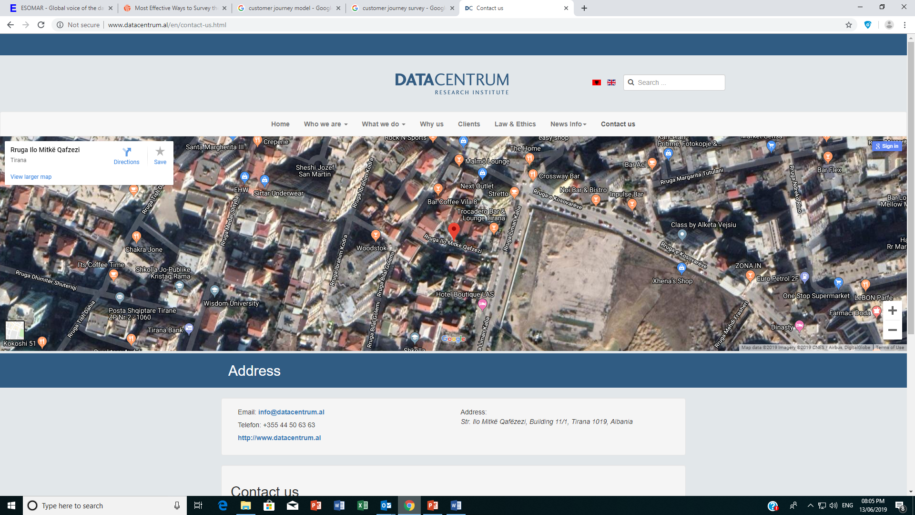
Thank you for your trust!
Independent private research agency
Str. “Ilo Mitkë Qafëzezi", Building No.11, Tirana 1060
T. +355 (0)44506363 / 42201100
Web. www.datacentrum.al
Ms. Sonila Çela
General Director
s.cela@datacentrum.al
T. +355 (0)42201100
M. +355 (0) 67 200 0022

